Slide 1








Speaker
Introduction to Azure Arc Enabled Data Services
Rob Sewell
SqlDbaWithBeard
September 16th & 17th
^{Online Event}
/robsewellsqldba
Powered By
International Conference

Slide 2

Thank you to all our generous sponsors
Sponsored by
Supported by
Powered by
Organized by

Slide 3
Why Azure Arc-Enabled Data Services?

Slide 4
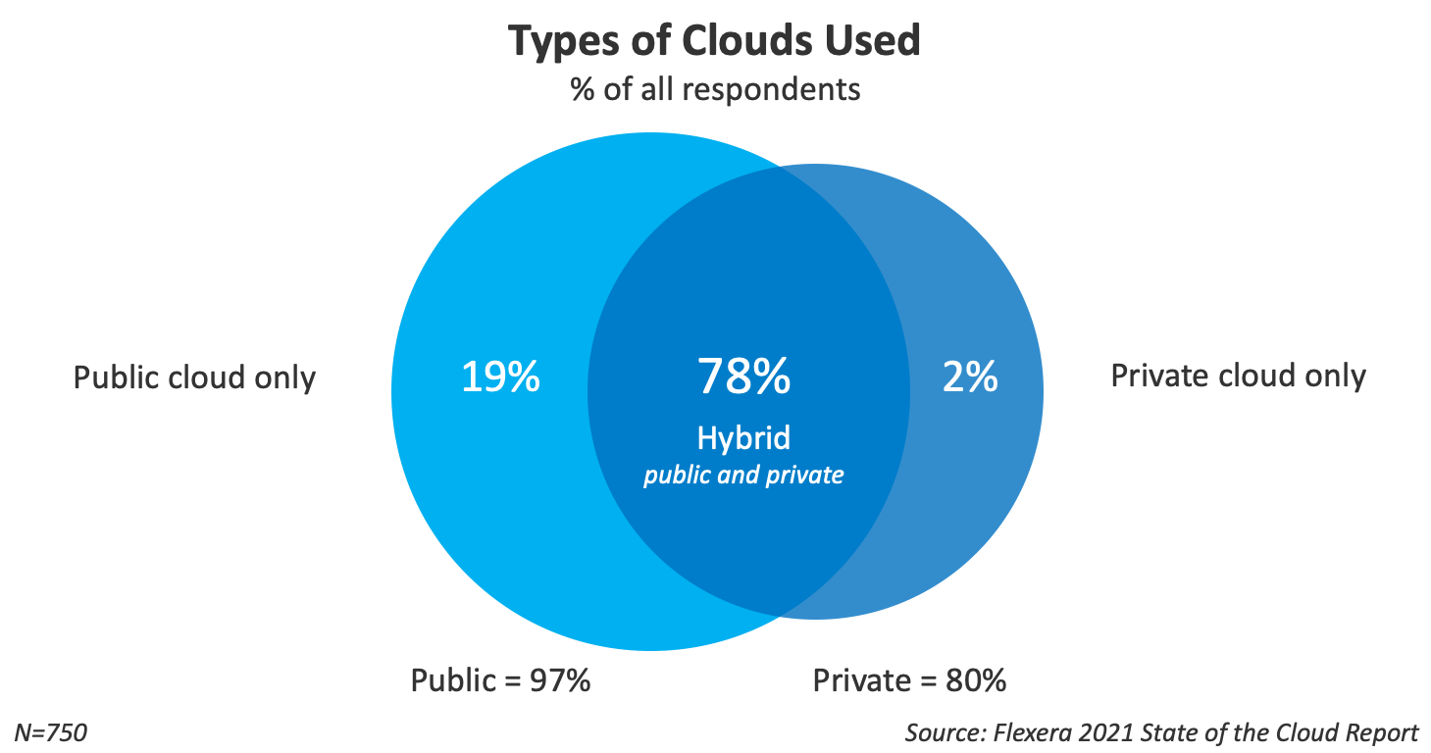

Slide 5
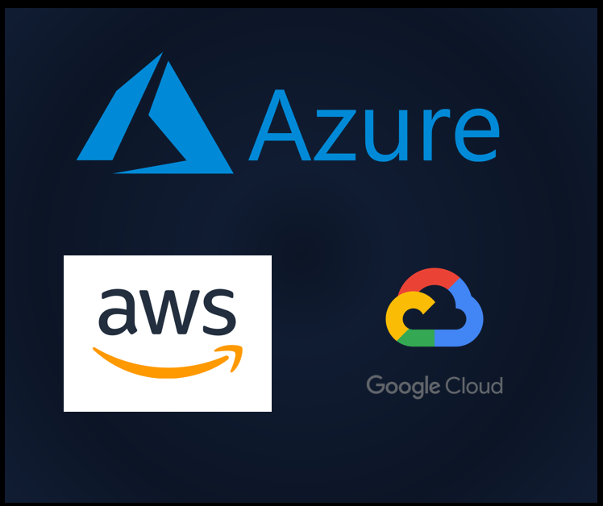

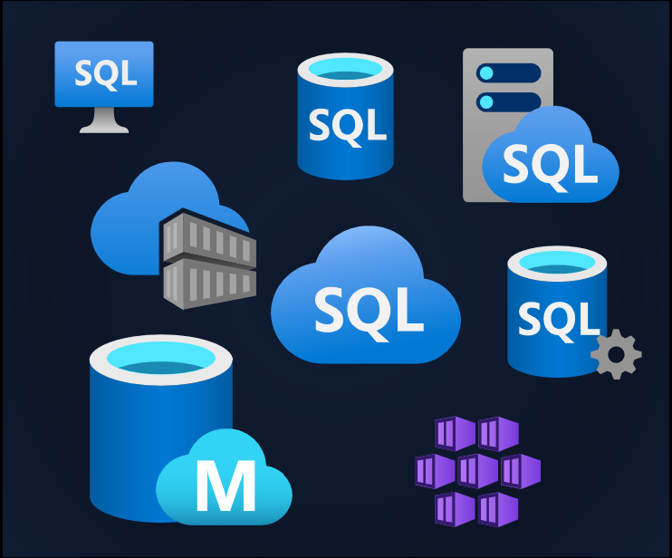
Our Services Are Everywhere

Slide 6


Management is Everywhere
Photo by Ashim D’Silva on Unsplash

Slide 7
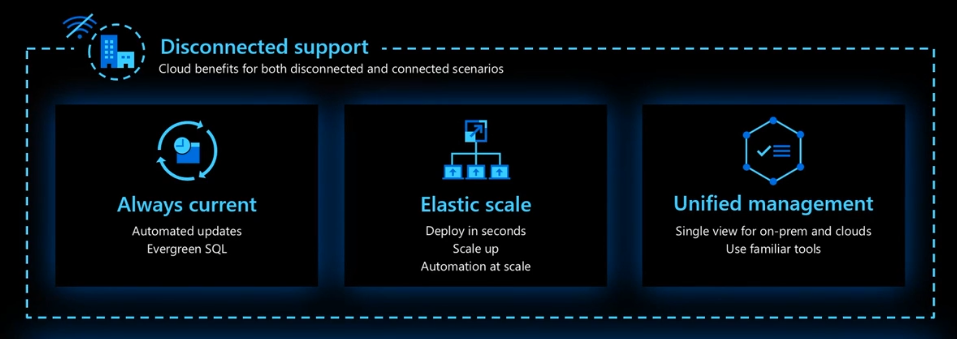

Azure Arc-Enabled Data Services Is Anywhere
Notes:
Azzure Management Services wherever your data services are
Deployments centralised
Operations, loggins, metrics, alerts – cetnralised
Inventory
Unified experience – A quick tools to find!

Slide 8

Azure Arc-Enabled Data Services Is Anywhere

Slide 9
Azure Arc-Enabled Data Services Is Anywhere

Slide 10
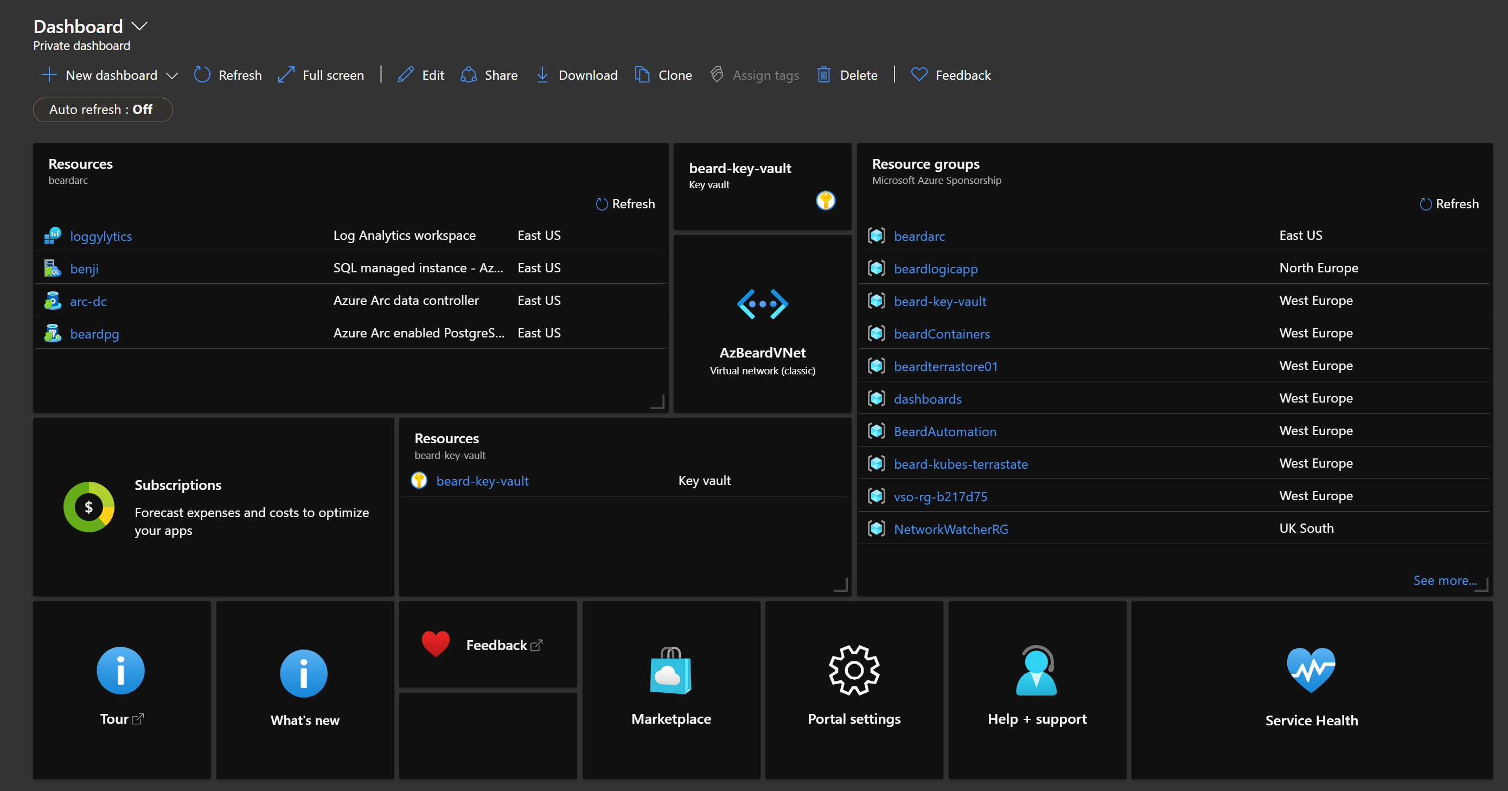
Azure Arc-Enabled Data Services Is Anywhere

Slide 11
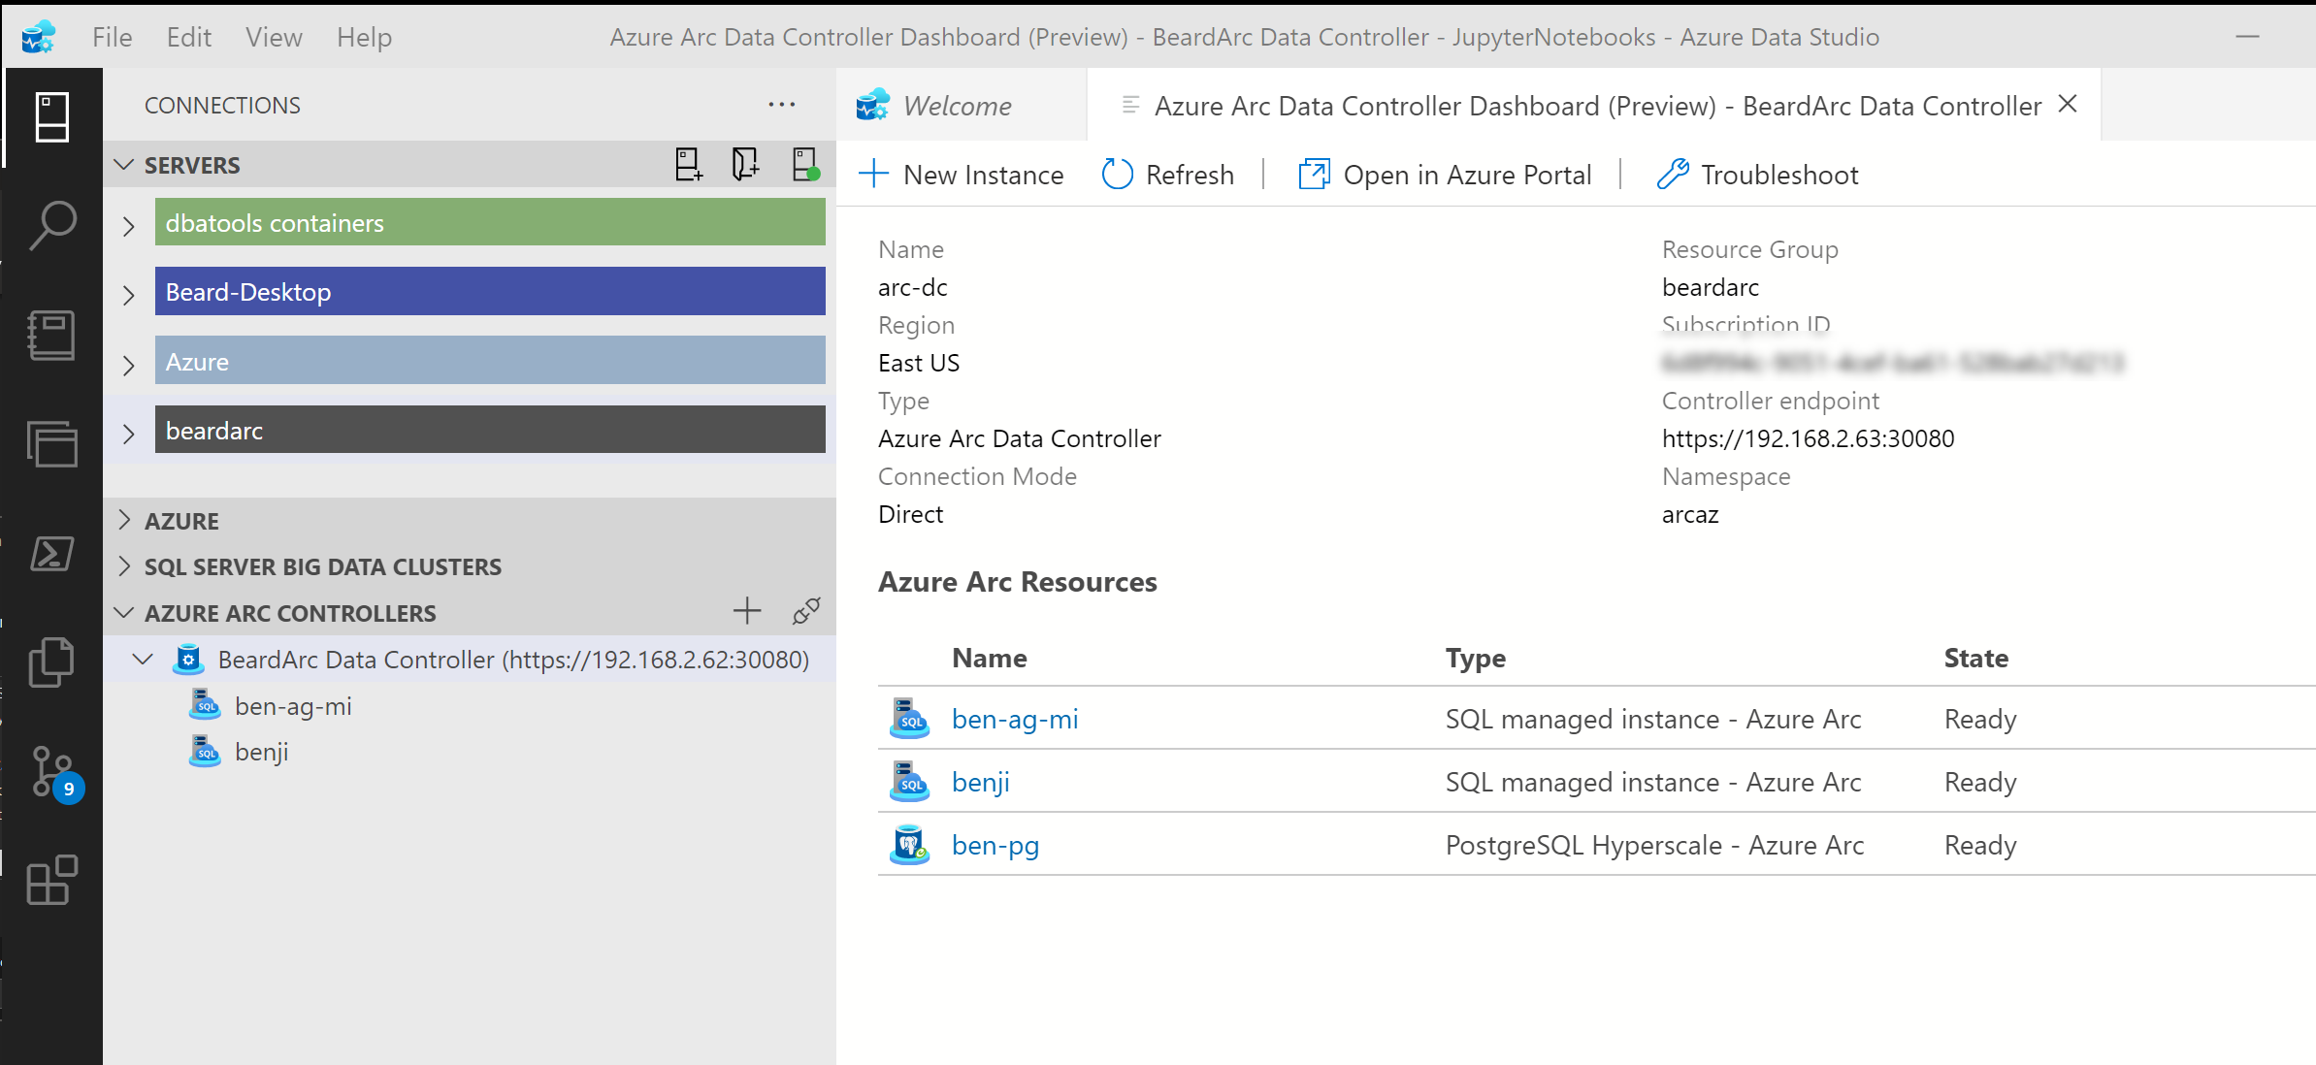
Azure Arc-Enabled Data Services Is Anywhere

Slide 12
Azure Arc-Enabled Data Services Is Anywhere

Slide 13








The Data Controller
Dashboards
Metrics
Logs
Backup/Restore
High Availability
Provisioning
API
Connectivity Modes
Directly Connected
Indirectly Connected
https://docs.microsoft.com/en-us/azure/azure-arc/data/connectivity
Notes:
Provides dashboards, metrics and logging built in
Controls High Availability, automated backup/restore in the plans
Enables Elastic Scale of CPU, RAM and Nodes for Availability Groups

Slide 14


Available Data Services
Azure Arc Enabled Managed Instance
Azure Arc Enabled PostgreSQL Hyperscale
Notes:
Lift and Shift version of SQL Server
Compatible with existing on-prem versions
Single Instance or Availability Group
Elastic Scaling
Open Source POstgreSQL database
Works with existing versions
v11 or v12
Self Service Provisioning using CLI,ADS, Portal, K8s
Always kept up to date (EverGreen)

Slide 15



Deployment
Azure Data Studio
Azure Data CLI
Kubernetes
With more options planned

Slide 16

Storage
Kubernetes
Decouples the state of the database from the lifecycle of the pods
Persistent Storage allocated from Storage Class
Specify Storage Class for
Data
Logs
App logs
Local Storage is on the Node
Remote Storage can be anywhere

Slide 17
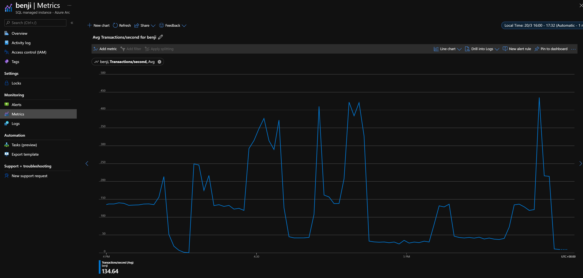
Metrics In the Portal

Slide 18
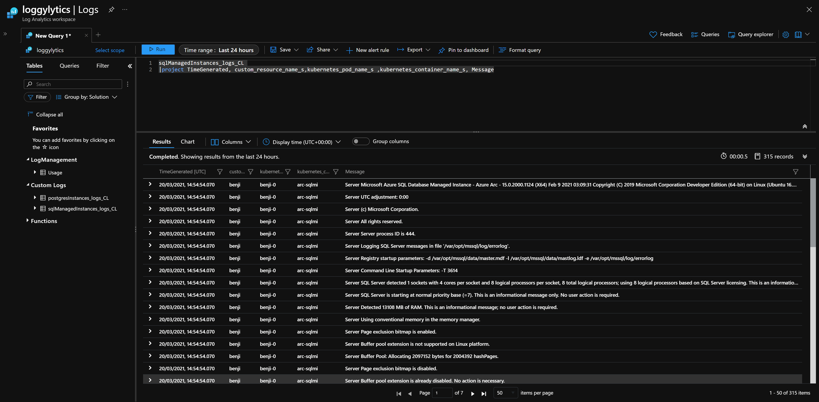
Logs In the Portal

Slide 19
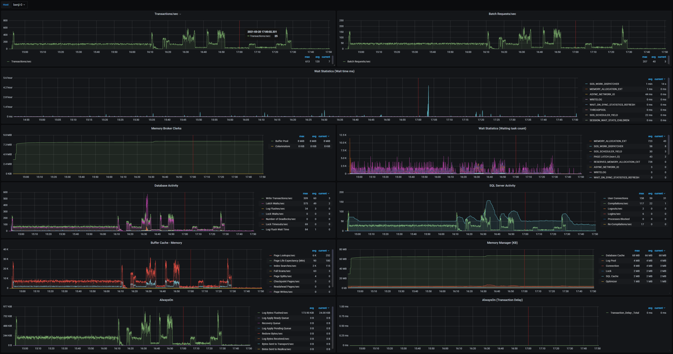
Metrics Built in

Slide 20
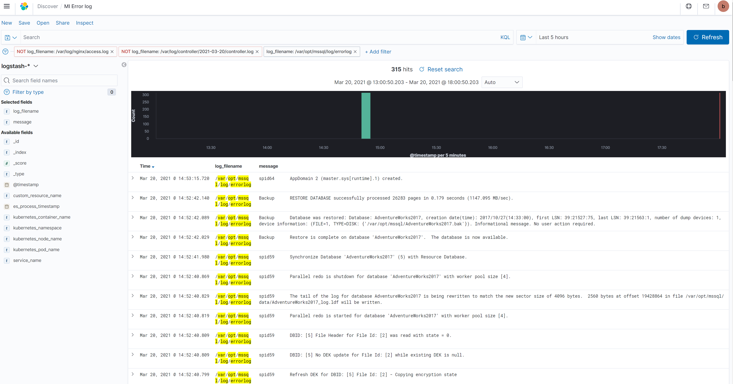
Logs Built in

Slide 21


Slide 22
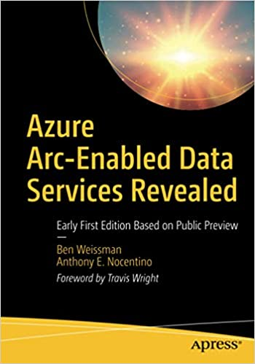
Resources for you
Azure Arc jumpstart
https://azurearcjumpstart.io
Azure Arc enabled data services
https://docs.microsoft.com/en-us/azure/azure-arc/data/
Azure Arc enabled SQL Managed Instance Overview
https://docs.microsoft.com/en-us/azure/azure-arc/data/managed-instance-overview
Azure Arc enabled PostgreSQL Hyperscale
https://docs.microsoft.com/en-us/azure/azure-arc/data/what-is-azure-arc-enabled-postgres-hyperscale
azdata reference
https://docs.microsoft.com/en-us/sql/azdata/reference/reference-azdata

Slide 23
DEMO TIME beard.media/arcdemo

Slide 24

Thank you
@sqldbawithbeard
robsewell.com
beard.media\book

Slide 25

Thank you!

